Slide 1


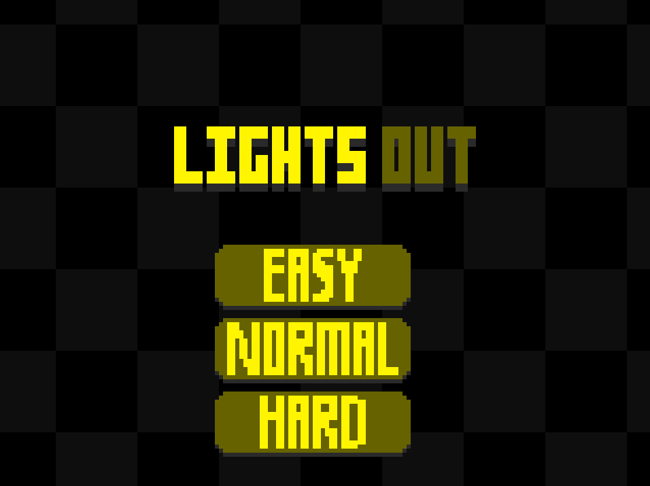
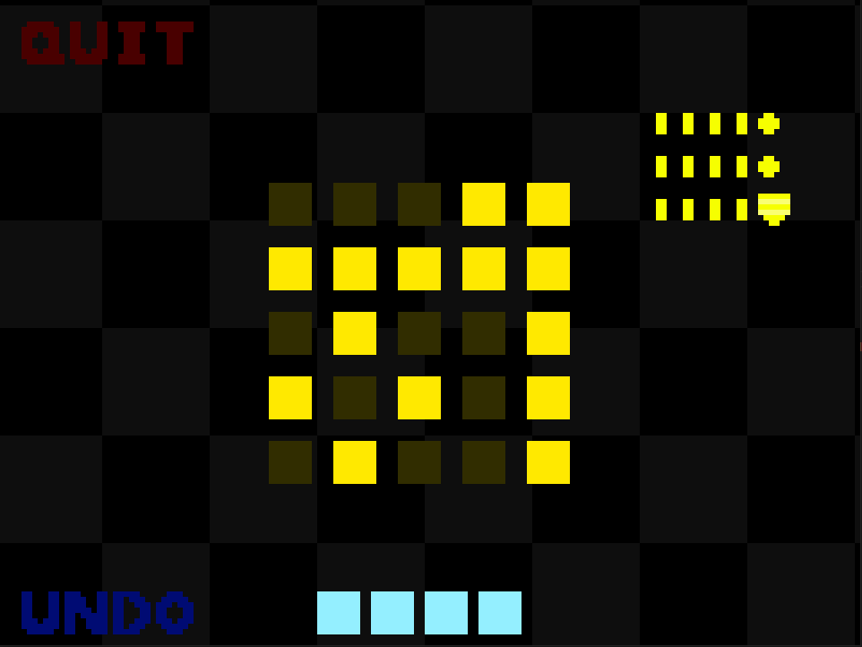
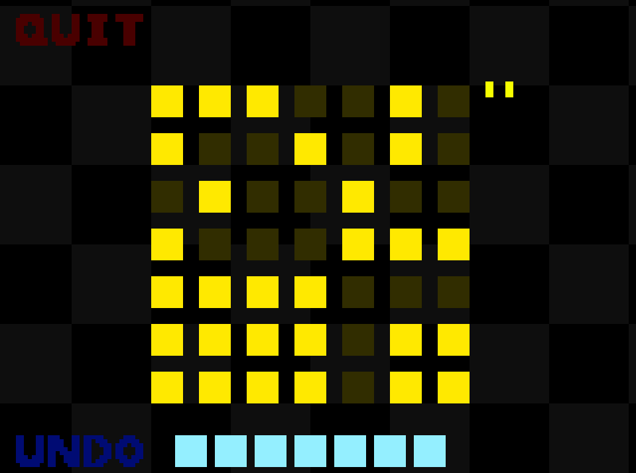
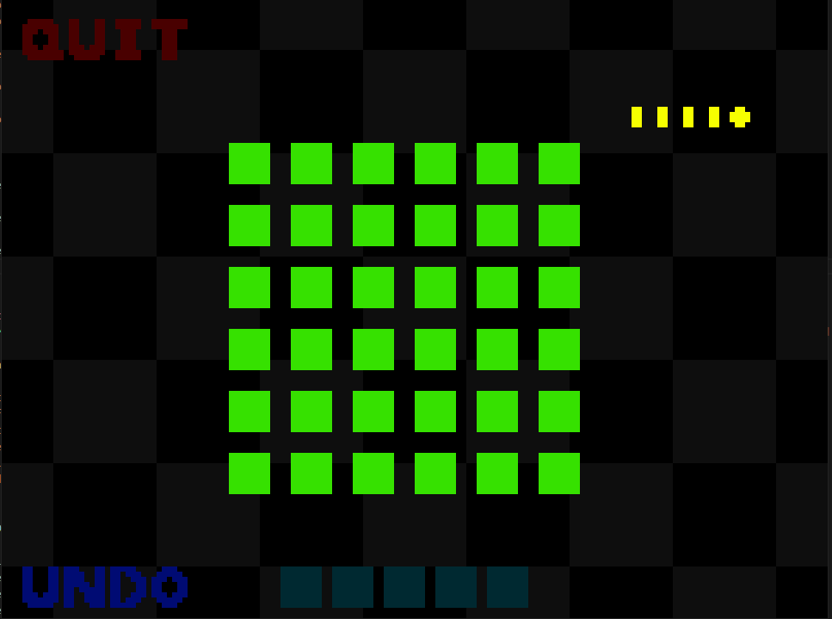
LIGHTS OUT
CLASSIC PUZZLES IN MODERN FORM
Developed by Declan Reuschel
https://github.com/ksu-is/lights-out

